Slide 1

Doubly stochastic gradient descent
EEE 606: Adaptive Signal Processing
Rajesh Sathya Kumar, M.S. Computer Science, On-Campus

Slide 2
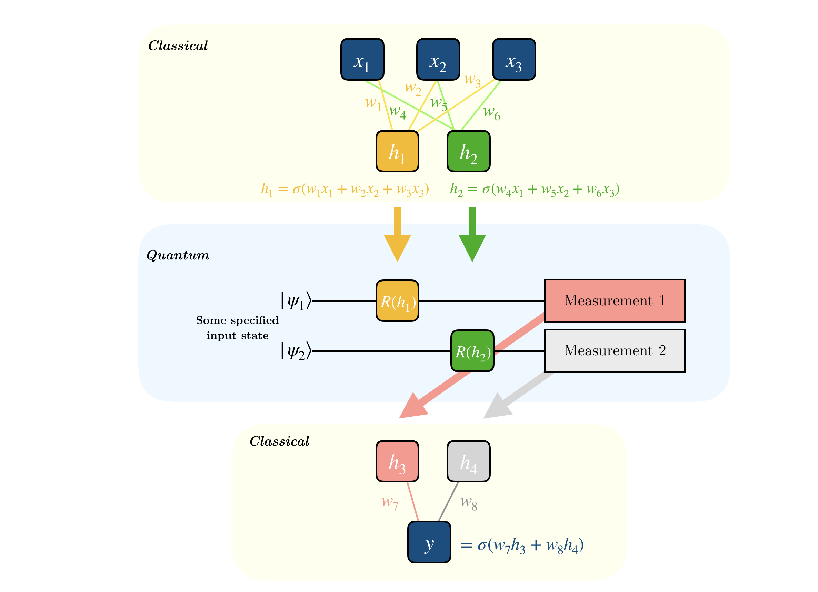
Overview
Problem Statement
Understand and implement stochastic gradient descent in quantum computation
Compare that will classical (vanilla) gradient descent
Objectives
1. Variational Quantum Eigensolver (VQE)
Implement Quantum doubly stochastic gradient descent (QSGD) using pennylane for VQE
Compare the convergence curve with vanilla gradient descent
2. Hybrid Neural Network + QSGD
Implement a Neural network with a Quantum Convolutional Layer using QSGD optimizer using pennylane
Compare its convergence curve with Vanilla GD
Note: The recorded video will discuss about the theory and results of QSGD for the above problems
Main Reference Paper:
Ryan Sweke, Frederik Wilde, Johannes Jakob Meyer, Maria Schuld, Paul K. Fährmann, Barthélémy Meynard-Piganeau, Jens Eisert. “Stochastic gradient descent for hybrid quantum-classical optimization.” arXiv:1910.01155, 2019.
General structure of a Hybrid quantum neural network

Slide 3
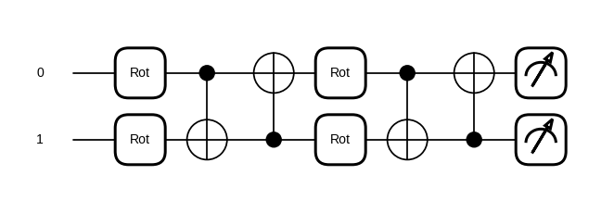

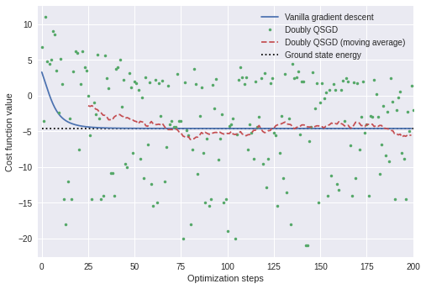



Preliminary Results
Variational Quantum Circuit (ansatz)
Theory: VQE:
We are given a Hamiltonian (Energy operator of a system) and we are trying to minimize the energy of the system using QSGD.
Gradient Update rule:
QGSD vs Vanilla Gradient Descent
Expectation of an operator
Loss function for a parameterized circuit
Hamiltonian as a sum of pauli matrices

Slide 4
Conclusion
Anticipated Results
VQE
The convergence curve is not as smooth as the vanilla gradient descent, but converges to the correct optimum
MNIST
Similarly, we should have the results converge to an optimum with a non-smooth curve
Accuracy might be slightly lesser than vanilla gradient descent
Major Takeaway
Stochastic gradient descent can be successfully implemented using quantum circuits
The QSGD algorithm optimizes to a local minima, but the convergence curve is not as smooth as the vanilla gradient descent
We have to use moving averages to properly minimize the loss function
My Learnings
Understood the theory of stochastic gradient descent
Learnt how to encode a stochastic optimizer for VQE problem

